Slide 1
worldbibleplans.com/languages/luganda/index.html
Ebiragiro by’omutendera ku mutendera

Slide 2
Ng'Omukristaayo, wali osomye Bayibuli yonna?
Lwaki nedda?
Nedda
Ng'Omukristaayo, kikulu nnyo okusoma Bayibuli yonna?
Nedda
Yee
Ekyo kyamuganyula nnyo mu bulamu bwo?
Yee
Wali okozesezza enteekateeka y'okusoma?
Yee
Nedda
Yee
Nedda
Kya baat ho gayi?
Kiki ekikulemesa okusoma Bayibuli yonna?
Kya baat ho gayi? Ekitabo kino kizibu okusoma?
Lwaki nedda? Pulaani ennyangu ey'okusoma yandisobodde okwongera ku miganyulo?
Omulimu gw'okusoma gwasobozesa omulimu guno okutambula obulungi?
Pulaani y'okusoma eya bulijjo yandisobozesezza omulimu okutambula obulungi?
Nedda
Yee
Kitwala obudde bungi?
Enteekateeka omuli n'ebyawandiikibwa ziba za ssente nnyingi?
Yee
Yee
Yee
Yee
Nedda
Yee
WBP erina enteekateeka ez'obwereere n'ebintu eby'enjawulo nga Chronological, M'Cheyne, n'ebirala okwongera ku bintu eby'enjawulo
WBP erina enteekateeka z'okusoma Bayibuli ku bwereere eziwagira okwewaayo okuva ku ddakiika 5 okutuuka ku ddakiika 60 buli lunaku oba ennaku zonna buli wiiki.
Paxful erina enteekateeka z'okuvvuunula ku bwereere mu ngeri ennyangu okusoma. N'emirimu egisinga obunene giba gisobola okukolebwa mu mitendera emitono era egy'enjawulo.
Ku WBP, tukkiriza nti okusoma Bayibuli kijja kutuganyula nnyo mu bulamu bwaffe.
Pulaani ki gye wakozesa? WBP erina ebika bingi eby'okulonda.
Gezaako enteekateeka ya FREE ku WBP
Bw'oba ogezezzaako okusoma Bayibuli n'olemwa okusoma Bayibuli, genda ku https://worldbibleplans.com/languages/Luganda/index.html era okole enteekateeka y'okusoma Bayibuli ku bwereere. Londa okuva mu nnimi ez'enjawulo, okuvvuunula, obudde bw'okuvvuunula, ebirowoozo, n'enteekateeka z'ebitabo. Kyangu bw'otyo. Kola pulaani, WBP agikola, era mu nnaku ezitakka wansi wa 1 ofuna linki y'okuggyamu pulaani yo ey'okusoma Bayibuli ey'obwereere ng'okozesa ebyawandiikibwa oba nga tebiriimu. Tukigamba nti buli kimu kya bwereere!

Slide 3
Mwaniriziddwa mu Nteekateeka za Baibuli z'Ensi Yonna
Kyangu okugoberera ebiragiro omutendera ku mutendera, mu nkola ya slayidi, okukola Enteekateeka yo ey’Okusoma Baibuli eya bulijjo.

Slide 4
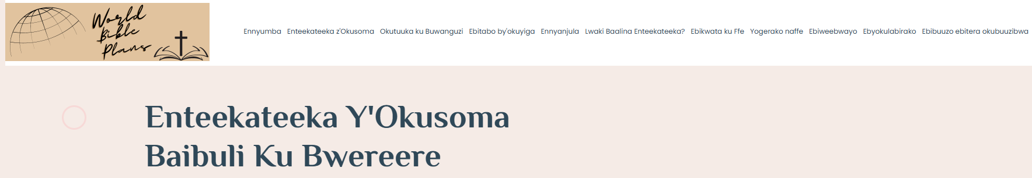
Genda ku lupapula lwa eBook Request

Slide 5
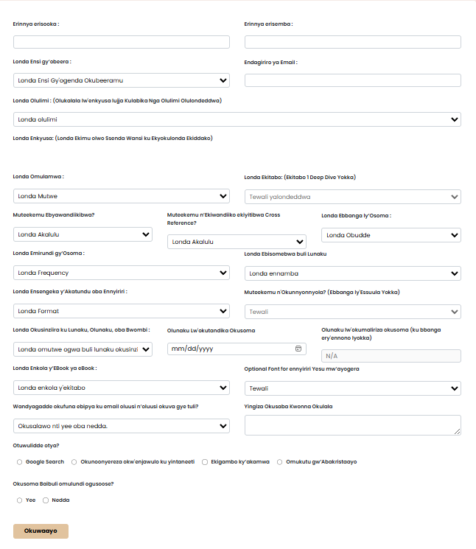
Eno ye Foomu y’Okusaba – Tujja kugimenyaamenya mu slide zino wammanga

Slide 6
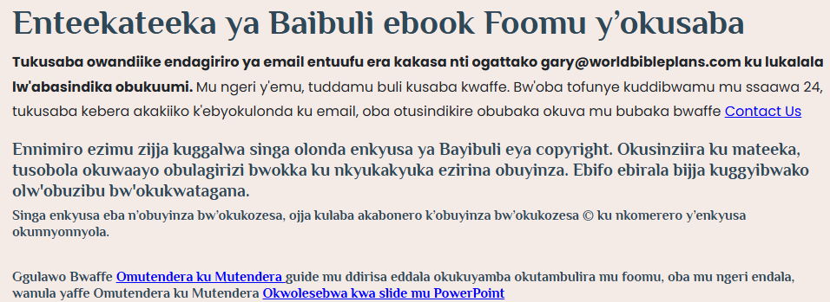
Makanika wa Ffoomu
Kikulu okujjuza foomu okuva ku kkono okudda ku ddyo n’okuva waggulu okutuuka wansi
  Singa ojjuza ekitundu ku foomu n’oluvannyuma n’okola enkyukakyuka mu kifo kye walonze edda, okulonda kwonna kujja kudda mu kusooka era ojja kufiirwa okulonda kwe wakola.
    Okugeza, singa olondawo enkyusa n’ojjuzaamu foomu endala n’oluvannyuma n’oddayo n’okyusa enkyusa, ojja kuba olina okuddamu okujjuzaamu ebifo byonna ebiddako

Slide 7
Amateeka agategeerekeka aga Ffoomu
Okusinziira ku by’olonze, ebimu ku by’olonze bijja kufuuka ebitaliiko
  Oluusi byonna bigwa wansi
  Oluusi okulonda kwokka munda mu drop down
    Okugeza: Singa olondawo enkyusa eriko eddembe ly’okukozesa, tetusobola kuwa byawandiikibwa, wabula okulambika kwokka.
      Select Book ejja kusibirwa
      Muteekemu Ebyawandiikibwa bijja kusibirwako kkufulu
        Nedda Okuwa Guide Only ejja default
      Muteekemu Cross References zijja kusibirwa
      Londa Akatundu/Verse ejja kusibirwa
      Londa eBook Format ejja kusibirwa
        PDF Chart ejja kusooka
      Optional Font y'ennyiriri Yesu mw'ayogera ejja kusibibwa

Slide 8
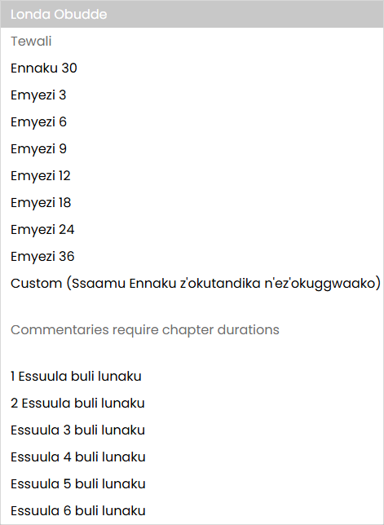
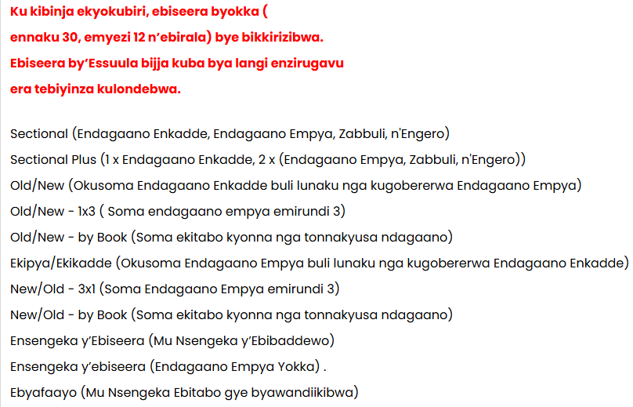
Amateeka Amatuufu aga Ffoomu Gagenda mu maaso
Ekyokulabirako ekirala: Singa olondawo omulamwa okuva mu kibinja ekyokubiri...
Ebiseera by'essuula mu Duration drop down bijja kuba bya langi enzirugavu era tebiyinza kulondebwa.
Commentary ejja kuba eggaddwa

Slide 9
Amateeka Amatuufu aga Ffoomu Gagenda mu maaso
Oluusi, okulonda okungi kwe kusalawo oba okulonda okulala kusibiddwa
  Okusobola okukomentinga okusobola okulondebwa:
    Version tesobola kuba na copyright
    Omulamwa gulina okuba mu kibinja ky’emiramwa ekisooka
    Ebbanga lirina okuba nga lya ssuula
  Okusobola Londa Akatundu oba Ennyiriri Format okusobola okulondebwa:
    Version tesobola kuba na copyright
    Muteekemu Ebyawandiikibwa birina okuba nga Yee
    Muteekemu Cross References zirina okuyisibwa oba Tewali Cross References zirina Okulondebwa

Slide 10
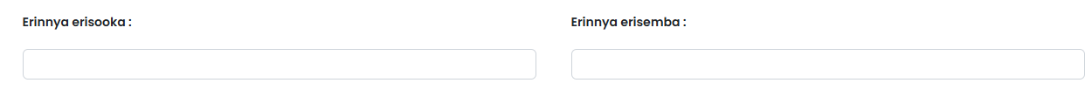
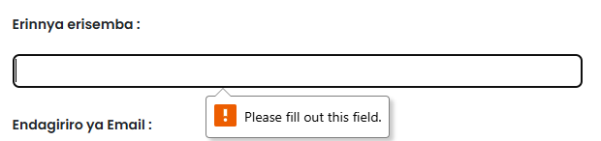
Tubuulire ky’oli
Ennimiro zino zikakatako
  Ekifo kyonna ekikakatako ekitajjuziddwa / ekirondeddwa kijja kuleeta ensobi ng’ossaayo era ojja kuba olina okujjuza ekifo

Slide 11
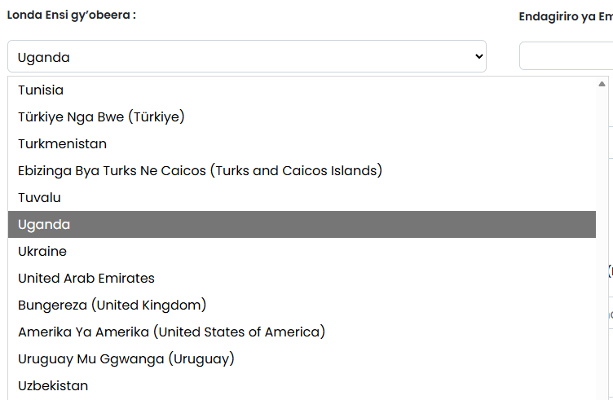
Londa Ensi gy’obeera okuva ku lukalala olukka wansi
Nywa ku drop down olabe olukalala lw’ensi gy’obeera
  Ssenda mu nsi gy’olonze oba
  Tandika okuwandiika okusobola okutuuka amangu mu nsi gy’olonze
  Nywa ku nsi gy’obeera gy’olonze
    Uganda mu kyokulabirako kino

Slide 12
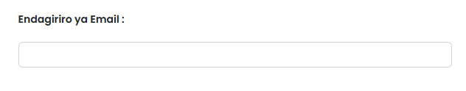
Yingiza endagiriro yo eya email
Twetaaga endagiriro yo eya email okukuweereza enteekateeka y’okusoma oba enkolagana gy’oyinza okuwanula enteekateeka yo ey’okusoma Baibuli eyakolebwa mu ngeri ey’enjawulo. Okuggyako ng’otusabye obutakikola ng’ossaayo okusaba kwo, WBP ejja kuweereza emails oluusi n’oluusi nga ziriko ebipya, enkyusa empya, n’enteekateeka empya
Tetujja kugabana email yo na muntu yenna olw'ensonga yonna

Slide 13
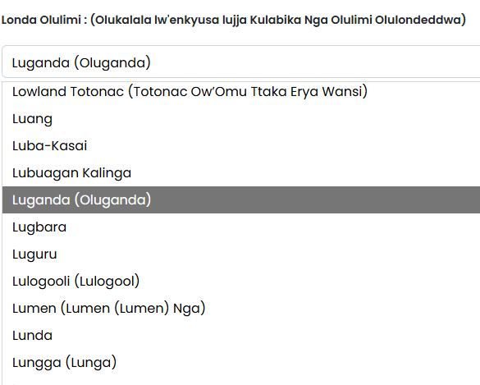
Londa Olulimi Lwo
Nywa ku kifo ekikka wansi olabe olukalala lw’ennimi
  Ssenda ku lulimi lw'olonze oba
  Tandika okuwandiika okusobola okutuuka amangu ku lulimi lw’olonze
  Nywa ku lulimi lw’olonze
    Oluganda mu kyokulabirako kino
Olulimi lw’olonda lwe lujja okusalawo olukalala lw’enkyusa za Baibuli z’osobola okulondamu

Slide 14
Olukalala lw'enkyusa olukwatagana n'olulimi lw'olonze lujja kujjula mu ngeri ya auto
Olukalala lw’enkyusa luli mu nnyiriri mu lulimi lwe walonze. Ennyonyola y’enkyusa eyo entongole ejja kukubuulira oba enkyusa eyo eri:
  Complete Bible – Ebitabo 66 (Endagaano Enkadde n’Empya)
  Baibuli enzijuvu ne x Ebitabo by’Ebitabo (Endagaano Enkadde n’Empya n’Ebitabo ebimu eby’Ebitabo. X ekiikirira omuwendo gw’ebitabo.
  Endagaano Empya Yokka – Ebitabo 27 eby’Endagaano Empya
  Endagaano Empya n'Ebitabo Ebirala - Ebitabo 27 eby'Endagaano Empya nga kwogasse n'omuwendo ogumu ogw'Ebitabo by'Endagaano Enkadde
  Endagaano Enkadde Yokka – Ebitabo 39 eby’Endagaano Enkadde
  Ebibulamu x Ekitabo(s) – Enkyusa ezimu zibulamu bitabo. x ekiikirira omuwendo gw’ebitabo ebibulamu
  x Ebitabo – Enkyusa ezimu zirina ebitabo ebitono. x ekiikirira omuwendo gw’ebitabo mu nkyusa

Slide 15
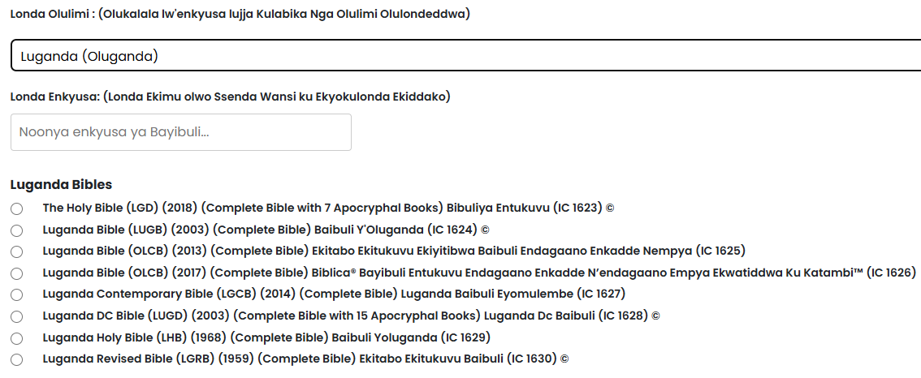
Kino kyakulabirako ky’ebyo by’oyinza okulaba
Noonya mu Lukalala okukendeeza ku by’olonze
(IC xxxx) ye koodi ey’omunda gye tukozesa mu kukola ku kusaba kwo

Slide 16
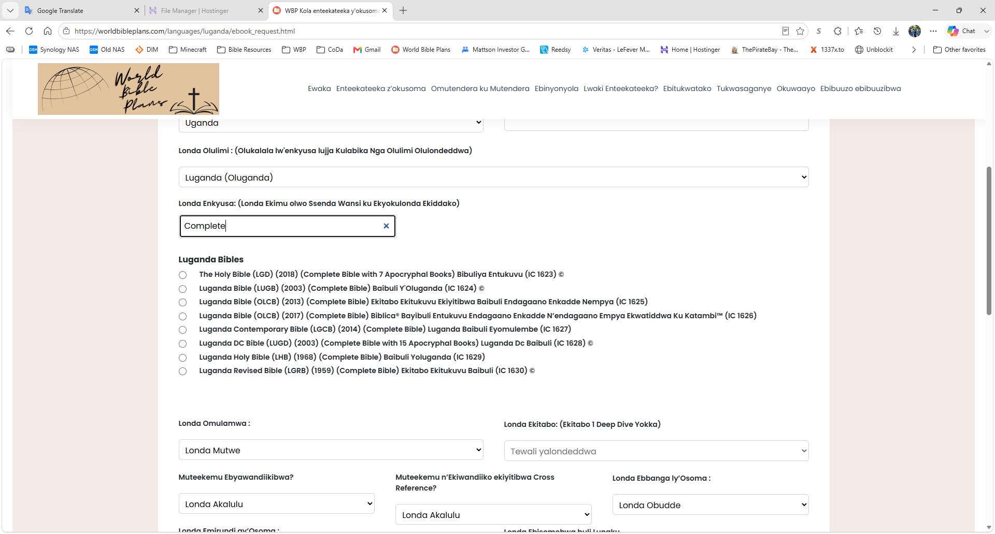
Noonya munda mu Lukalala
Noonya mu Lukalala okukendeeza ku by’olonze
Mu kyokulabirako kino, nanoonya munda mu lukalala lwa “Complete”

Slide 17

Enkyusa ezirina eddembe ly’obuntu
Ennimiro ezimu ku foomu zijja kusibibwa singa olondawo enkyusa ya Baibuli eriko olukusa lw’okukozesa. Mu mateeka, tusobola okuwa obulagirizi bwokka ku nkyusa ezirina eddembe ly’okukozesa. Ojja kulaba akabonero k’obuyinza bw’okuwandiika © ku nkomerero y’ennyonnyola y’enkyusa.
Mu mateeka, tetukkirizibwa kuwaayo byawandiikibwa ku nkyusa za Baibuli wansi w’obuyinza obuliwo kati. Enkyusa yonna eri wansi wa copyright eriwo kati ejja kuba n'akabonero © ku nkomerero. Ku nkyusa zino, tusobola okuwa obulagirizi bwokka.

Slide 18
Nywa mu bbaatuuni ya radial ku ntandikwa y’okulonda kwo
Mu kyokulabirako kino, nnonze... Luganda Bible (OLCB) (2013) (Complete Bible) Ekitabo Ekitukuvu Ekiyitibwa Baibuli Endagaano Enkadde Nempya (IC 1625)
  Weetegereze: Osobola okulondako kumu kwokka buli kusaba. Bw’oba ​​oyagala enkyusa eziwera, olina okuleeta okusaba okungi

Slide 19
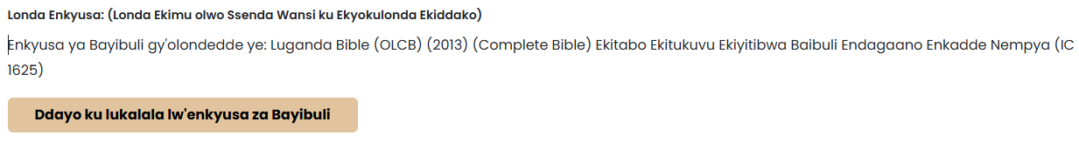
Olukalala olukka wansi lujja kuggalwa era foomu ejja kulaga enkyusa gye walonze
Osobola okukyusa ky’olonze ng’onyiga ku back to versions
  Kino bw’okikola ng’omaze okujjuza foomu esigadde, ojja kuba olina okuddamu okujjuza foomu

Slide 20
Emiramwa
Emiramwa giwa engeri ez’enjawulo ez’okusoma ebyawandiikibwa
  Emiramwa egimu giwa ensengeka y’okusoma
    Eby’okulabirako :
      Obugolokofu (Olubereberye okutuuka mu Kubikkulirwa) .
      Ensengeka y’ebiseera
  Emiramwa emirala gikukuuma ng’ossa essira ku ndowooza emu oba okwanjula ebyawandiikibwa mu ngeri emu ey’amakulu
    Eby’okulabirako :
      Okusinziira ku mutindo
      M’Cheyne
  Emiramwa egimu gikuleetedde essira ku kitabo kimu oba ebitabo ebisunsuddwa
    Eby’okulabirako :
      1 Ekitabo Deep Dive
      Abatume ne Pawulo
Emiramwa gyonna ginnyonnyoddwa mu bujjuvu ku lupapula lw’Enteekateeka z’Okusoma oluyingizibwa okuyita mu menu
Zuula omulamwa ogusinga okukukolera

Slide 21
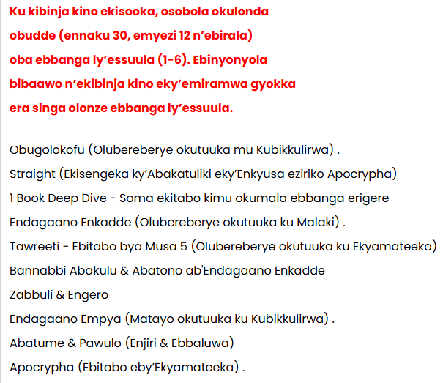
Emiramwa Gigenda mu maaso
Emiramwa gikutuddwamu ebibinja bina okusinziira ku kukyukakyuka kw’obudde (obuwanvu bw’obudde bw’okusoma) n’emirundi (ennaku mmeka mu wiiki gy’osoma) .
  Ekibinja 1 - Ku kibinja kino ekisooka, osobola okulonda Obudde (ennaku 30, emyezi 12, n’ebirala) oba Essuula 1-6 buli lunaku ebiseera by’olunaku lw’okusoma
Ebinyonyola bibaawo n’ekibinja kino eky’emiramwa gyokka era singa olonze ebbanga ly’essuula.

Slide 22
Emiramwa Gigenda mu maaso
Ekibinja 2 - Ku kibinja ekyokubiri, Ebiseera byokka (ennaku 30, emyezi 12, n’ebirala) bye bikkirizibwa.
  Ebiseera by’Essuula bijja kuba bya langi enzirugavu era tebiyinza kulondebwa.
Ebiteeso tebiriiwo na kibiina kino

Slide 23
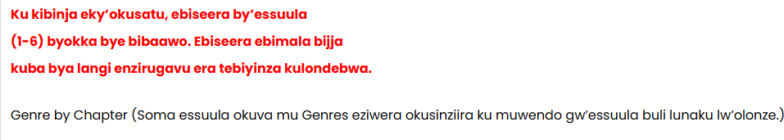
Emiramwa Gigenda mu maaso
Ekibinja 3 - Ku kibinja eky’okusatu, ebiseera by’Essuula 1-6 byokka bye bibaawo.
  Ebiseera ebimala bijja kuba bya langi enzirugavu era tebiyinza kulondebwa.
Ebiteeso tebiriiwo na kibiina kino

Slide 24
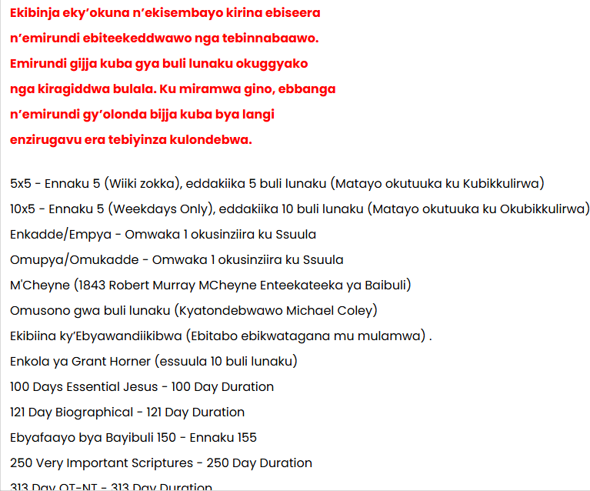
Emiramwa Gigenda mu maaso
Ekibinja 4 - Ekibinja eky’okuna n’ekisembayo kirina ebiseera n’emirundi ebiteekeddwawo nga tebinnabaawo.
  Emiramwa gino girina emirundi gya buli lunaku okuggyako nga kiragiddwa bulala.
  Ku miramwa gino, ebbanga n’emirundi gy’olonda bijja kuba bya langi enzirugavu era tebiyinza kulondebwa.
Luno lukalala lwa kitundu kyokka
Ebiteeso tebiriiwo na kibiina kino

Slide 25
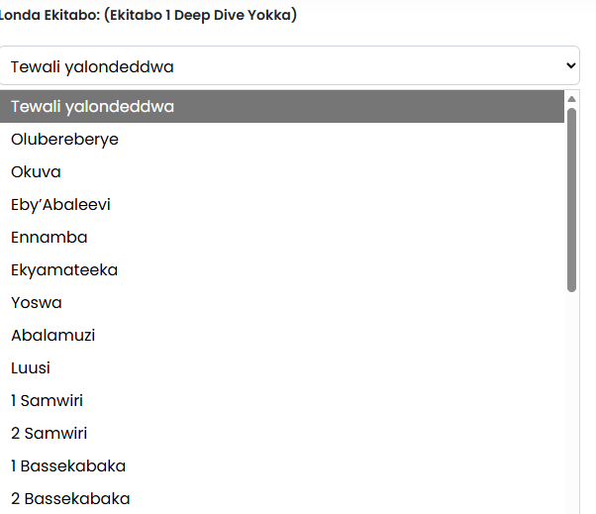
Bw’oba ​​olonze omulamwa gwa 1 Book Deep Dive, londa ekitabo. Bwe kitaba ekyo, enkola eno ejja kuba esibiddwa
Ebitabo ebikwata ku Apocryphal tebiri mu lukalala. Olubereberye lwokka thru Okubikkulirwa
Ekitabo kimu kyokka kye kiyinza okulondebwa
Ebitabo ebiriwo bisinziira ku nkyusa yo
  Screen si magezi okumanya ebitabo ebiri mu buli version.
  Kiri gy’oli okulonda ekitabo ekisangibwa mu nkyusa gy’olonze
    Kale okugeza, bw’oba ​​walonze enkyusa eri mu Ndagaano Empya Yokka, tolondawo Olubereberye wano

Slide 26
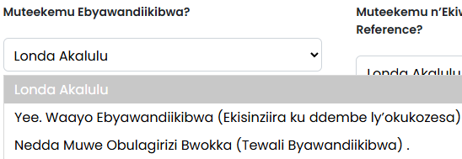
Muteekemu n’Ebyawandiikibwa
Okulonda kuno kuliwo ku nkyusa ezitali za copyright zokka
Londako wakati wa
  Yee. Waayo Ebyawandiikibwa – Teekamu ebyawandiikibwa mu nteekateeka yo ey’okusoma
  Nedda Waayo Obulagirizi Bwokka – Tossaamu byawandiikibwa
    Enkola eno erimu emitwe gyokka egya buli lunaku (gisangibwa mu nkola ya pdf chart)
    Enkola eno eri abo abaagala okukozesa Baibuli yaabwe eya kkopi oba ku nkyusa za Baibuli eziri wansi w’obuyinza bw’okukozesa obuliwo kati

Slide 27
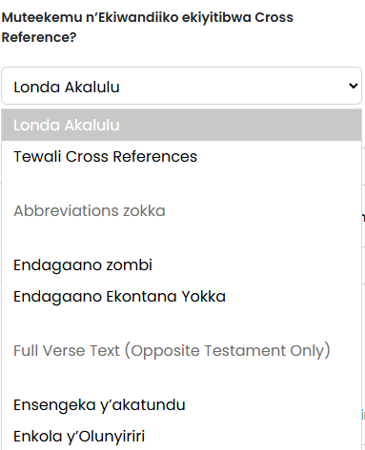
Okwesalirawo londa okussaamu Cross References
Laba empapula zino wammanga okufuna ebyokulabirako
Londa wakati w’ebifupi n’ebijuliziddwa mu byawandiikibwa
  Ku biwandiiko by’ennyiriri mu bujjuvu, WBP egaba ebiwandiiko by’Endagaano Empya ku nnyiriri z’endagaano enkadde ne vice versa.
  Ku bifupi, WBP egaba ebiwandiiko byonna ebisalasala oba ebijuliziddwa mu Ndagaano Empya ku nnyiriri z’Endagaano Enkadde ne vice versa.
Cross references teziriiwo ku nkyusa ezirina copyright.
Muteekemu Ebyawandiikibwa birina okuba Yee.
Bw’osalawo okuba ne Cross References, okulonda Paragraph/Verse kujja kusibirwa
  Ekola n’ensengeka y’ennyiriri yokka.
Google AI - Baibuli cross-reference ye note elungamya omusomi ku lunyiriri oba ekitundu ekirala mu Baibuli ekirina omulamwa, ekigambo oba ekirowoozo ekikwatagana, ekiyamba okuyunga ebitundu eby’enjawulo eby’ebyawandiikibwa n’okutumbula okutegeera. Ebiwandiiko bino bikwataganya endowooza, obunnabbi, n’ebintu ebikwatagana, ne kisobozesa ekitundu ekimu okuta ekitangaala ku kirala.

Slide 28


Muteekemu Cross Reference – Ebyokulabirako by’Ebifupi
Ekyokulabirako 1 – Ebifupi byonna. Mu kyokulabirako kino, mulimu ebiwandiiko ebijuliziddwa mu Ndagaano Enkadde n’Endagaano Empya
Eky’okulabirako 2 – Enfunyiro y’Endagaano ekontana yokka. Mu kyokulabirako kino, waliwo ebigambo byokka ebijuliziddwa mu Ndagaano Enkadde

Slide 29


Muteekemu Cross Reference – Eby’okulabirako by’Ebiwandiiko Ebijjuvu
Ekyokulabirako 3 – Ebijuliziddwa mu nnyiriri mu bujjuvu. Mu kyokulabirako kino, waliwo ebijuliziddwa mu Ndagaano Enkadde byokka mu nkola y’akatundu
Ekyokulabirako 4 – Ebijuliziddwa mu nnyiriri mu bujjuvu. Mu kyokulabirako kino, waliwo ebijuliziddwa mu Ndagaano Enkadde byokka mu nkola y’olunyiriri

Slide 30
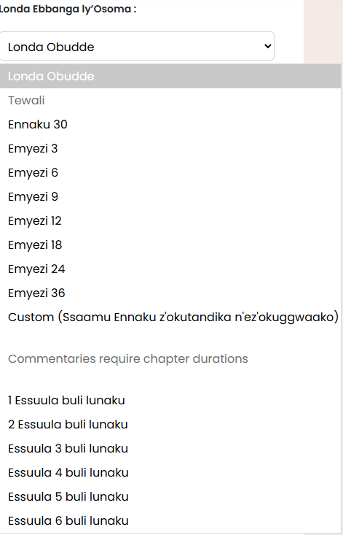
Ebbanga ly’Okusoma
Londa wakati w’Ekiseera n’Ebbanga ly’Essuula
  Londa okuva mu nnaku entono nga 30 oba okumala emyaka 3.
  Oba Londa okuva mu ssuula 1-6 buli lunaku
    Ebbanga ly’essuula lye limala lisinziira ku nkyusa gy’olonze. Mu Bayibuli y’ekitabo 66, mulimu essuula 1189
      Essuula 1 buli lunaku = ennaku 1189 = emyaka 3.27 (emyaka 3, emyezi 3)
      Essuula 2 buli lunaku = ennaku 595 = emyaka 1.63 (omwaka 1, emyezi 7 1⁄2)
      Essuula 3 buli lunaku = ennaku 396 = emyaka 1.1 (omwaka 1, omwezi 1)
      Essuula 4 buli lunaku = ennaku 297 = emyaka 0.81 (emyezi 10) .
      Essuula 5 buli lunaku = ennaku 237 = emyaka 0.65 (emyezi 8) .
      Essuula 6 buli lunaku = ennaku 198 = emyaka 0.54 (emyezi 6 1⁄2) .
  Oba londa Custom bw’oba ​​oyagala okulonda olunaku lw’okutandika n’okumaliriza
  Ebinyonyola bibaawo n’obuwanvu bw’essuula bwokka
  Possible Duration selections zisinziira ku mulamwa gw’olonze

Slide 31
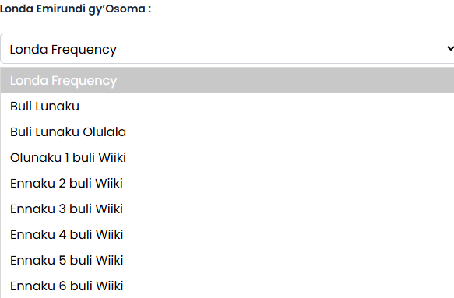
Londa Emirundi gy’Osoma
Londa ku:
  Buli Lunaku
  Buli Lunaku Olulala
  Ennaku 1-6 buli Wiiki
    Zino zigenda kuba za nnaku ez’omuddiring’anwa
      Bw’olonda ennaku 3 buli wiiki, ojja kusoma okumala ennaku ssatu ez’omuddiring’anwa era ojja kuwummula ennaku 4

Slide 32
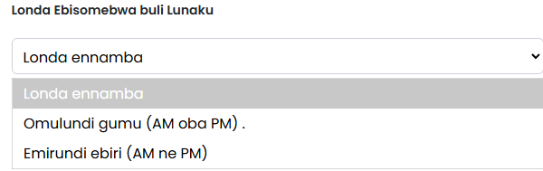
Londa Ebisomebwa buli Lunaku
Londa ku:
  Omulundi gumu buli Lunaku (a.m. oba p.m.)
  Emirundi ebiri buli Lunaku (a.m. ne p.m.)
    Okusoma kwa buli lunaku kujja kwawulwamu kyenkanyi wakati wa AM ne PM

Slide 33
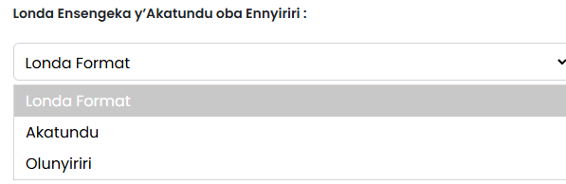


Londa Ensengeka y’Akatundu oba Ennyiriri
Ekyokulabirako ky’akatundu
Ekyokulabirako ky’olunyiriri
Bw’osalawo okuba n’ebijuliziddwa ebisalasala, ensengeka y’ennyiriri ejja kulondebwa mu ngeri ey’otoma

Slide 34

Teekamu Ennyonyola - Londa ennyonyola essuula ku ssuula egenda okuteekebwa mu nteekateeka yo.
Ebinyonyola bikuŋŋaanyiziddwa mu bibinja okusinziira ku nnyiriri okusinziira ku lulimi
Londa okuva mu bigambo 155 mu nnimi 15
  Kino kya kwesalirawo. Bw’oba ​​toyagala commentary, leka nga None
Ennyonyola z’essuula ku ssuula zisangibwa n’ekibinja ky’emiramwa ekisooka kyokka era singa olonze ebbanga ly’essuula

Slide 35
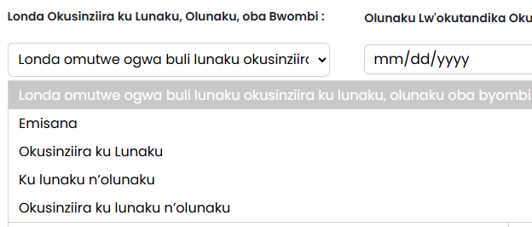
Londa Okusinziira ku Lunaku, Olunaku, oba Bwombi
Ku lunaku – Ekyokulabirako – Olunaku 1, Olunaku 2, n’ebirala.
Okusinziira ku Lunaku – Eky’okulabirako – January 1, January 2, n’ebirala.
Okusinziira ku Misana n’Olunaku – Omutwe gujja kulaga byombi nga Olunaku lusoose
Ku Lunaku n'Olunaku - Omutwe gujja kulaga byombi n'Olunaku okusooka

Slide 36
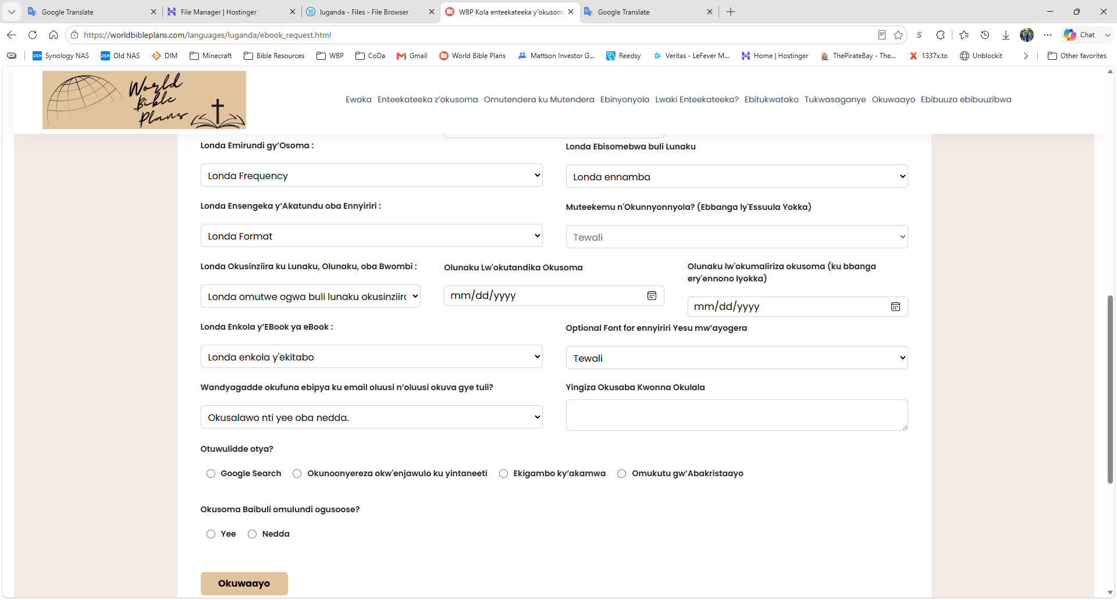


Nywa ku kalenda okulonda olunaku lw’okusoma okutandika. Bw’oba ​​walonze Custom Duration, londa olunaku lw’okusoma okuggwaako
Olunaku lw'okutandika kikakatako ne bw'oba olonze omutwe gw'Olunaku
Yingiza omuwendo gwokka singa olonze Custom Duration
Olunaku lw'okumaliriza okusoma lujja kuba terusobola kulondebwa okuggyako ng'olonze Custom Duration mu Duration drop down

Slide 37
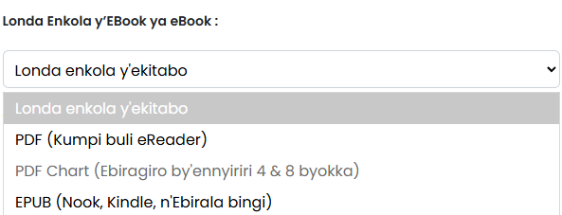
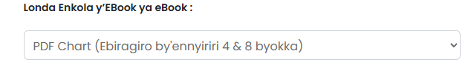
Londa Enkola ya eBook
Bw’oba ​​ossaamu ebyawandiikibwa, londa wakati wa PDF ne Epub
Singa enkyusa yo erina copyright oba singa olonze ekitabo ekikulaga, okulonda kuno kujja kusibirwa nga PDF Chart ye default
Esobola okulondebwa singa Muteekemu Ebyawandiikibwa eba Yee
Okulonda kwo kwesigamye ku eReader yonna gy’oyagala okukozesa.
  PDF – Enkola ya bonna ekozesebwa web browsers n’abasomi abalala abasinga obungi ku e-Readers
  EPUB – Okulonda kuno kukozesebwa mu Barnes and Noble Nook App, Amazon Kindle App, ne apps endala ezisinga ez’abasomi ku yintaneeti
    Fayiro ya EPUB eBook ntono nnyo mu bunene
Osobola okulondako emu yokka ku zino. Bw’oba ​​oyagala okuba n’enteekateeka yo ey’okusoma mu nkola endala (nga txt, docx, mobi, n’ebirala,) tutegeeze mu kasanduuko k’okuwandiika okusaba kwonna okw’enjawulo wano era tujja kugezaako okusikiriza.

Slide 38
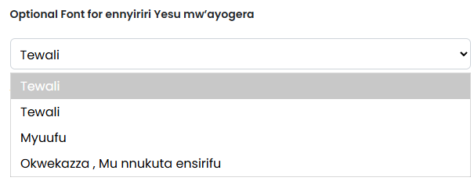
Optional Font for ennyiriri Yesu mw’ayogera
Olunyiriri lwonna, Yesu mw’ayogera, mu ngeri ey’okwesalirawo luyinza okuba mu nnukuta emmyufu oba enzirugavu, mu nnukuta enkwafu.
  Bypass this selection oba londa None okukozesa efonti esookerwako
Enkola eno ebaawo singa ossaamu Ebyawandiikibwa
Ebiwandiiko ebikwata ku cross reference biggyibwa mu fonts ez'okwesalirawo

Slide 39
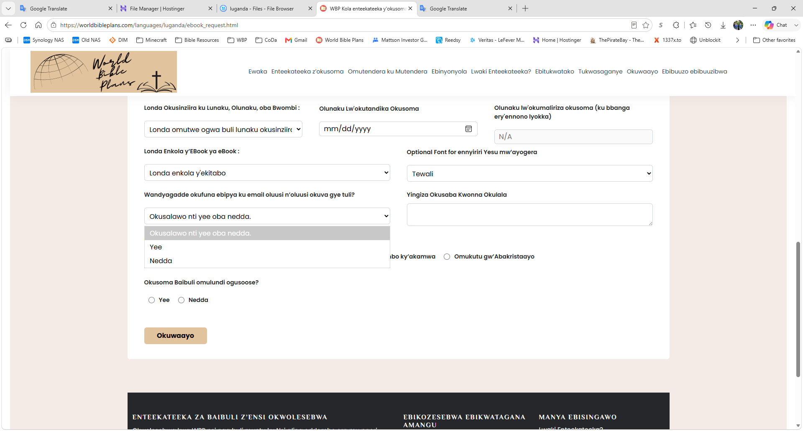
Okwesalirawo: Londa Nedda bw’oba ​​oyagala obutafuna email okuva mu WBP mu biseera eby’omu maaso

Slide 40
Okwesalirawo: Yingiza wano okusaba kwonna okw'enjawulo
Osobola okukola okusaba kwonna okw’enjawulo mu kasanduuko k’ebiwandiiko aka ffoomu ey’obwereere.
Okugeza, oyinza okwagala enteekateeka yo ey’okusoma mu ngeri eziwera oba mu nkola ey’enjawulo okuggyako eyo ewandiikiddwa. Tujja kukkiriza okusaba kwonna bwe tunaasobola.
Oyinza okwagala okutabula n’okukwatagana. Londa Endagaano Enkadde okuva mu nkyusa emu ate endagaano empya okuva mu ndala okugeza.
  Kino osobola okukikola ng’oyita mu kusaba okw’enjawulo oba okutuweereza akawandiiko okuva ku mukutu gwaffe ogwa Tukwasaganye
  Okusaba okw’ekika kino kujja kutwala ekiseera kitono okukola ku nkomerero yaffe

Slide 41
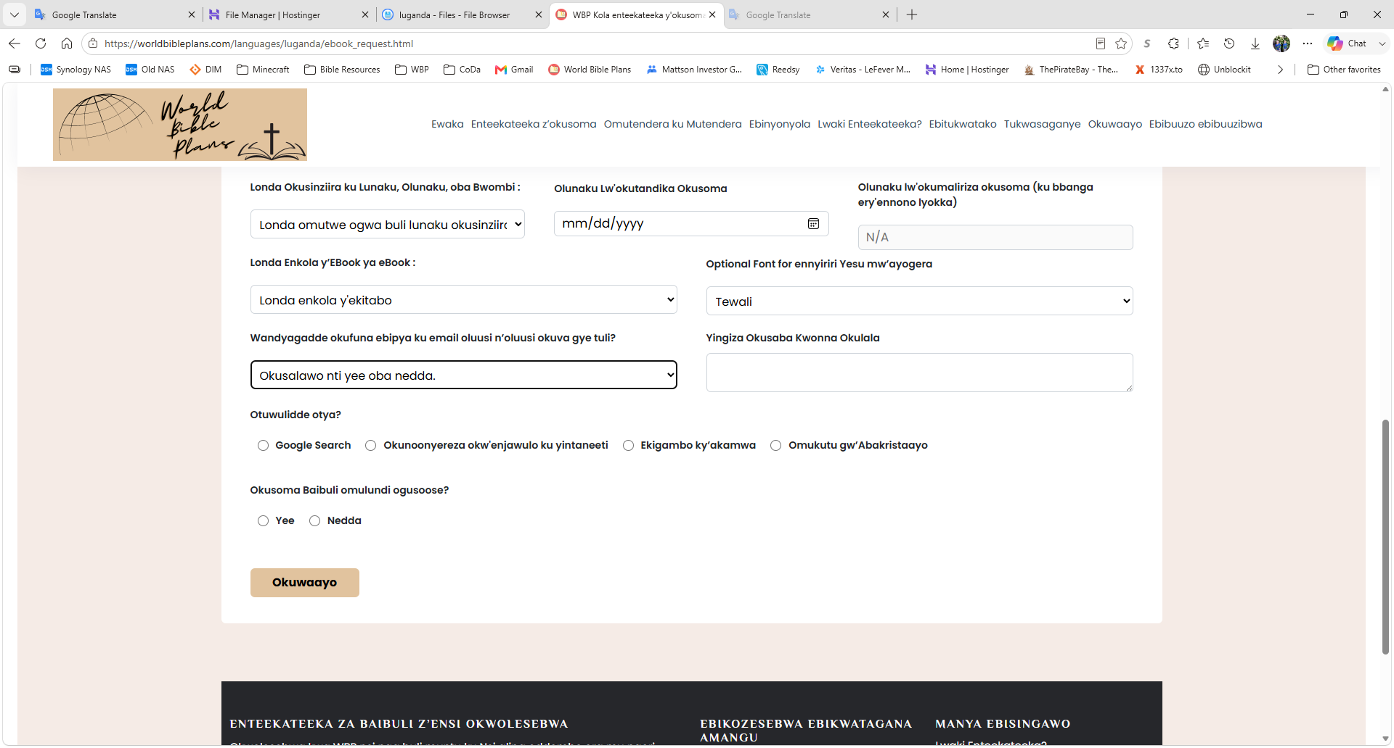
Tusaba otutegeeze engeri gye watuwuliddemu era oba guno gwe mulundi gwo ogusoose okusoma Baibuli
Amawulire gano gajja kutuyamba okutuuka ku bantu bangi nga bwe kisoboka

Slide 42
Nywa ku Submit
Bw’oba ​​ojjuzaamu foomu mu bujjuvu nga tosubwa kulonda kikakatako, ojja kulagirwa ku lupapula lw’okukakasa
Bw’oba ​​wasubiddwa okulonda, ojja kusabibwa okujjuza ekifo oba okukola okulonda.

Slide 43
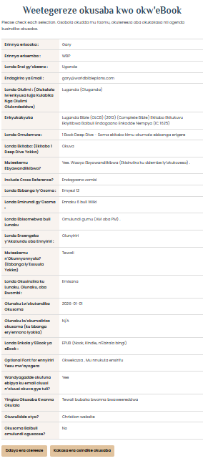
Omuko gw'okukakasa

Slide 44
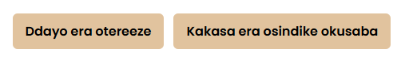
Omuko gw'okukakasa gugenda mu maaso
Bw’oba ​​omatidde n’ebyo by’olonze, nyweza ku Confirm ne Send Request
Bwe kitaba bwe kityo, osobola okuddayo n’olongoosa

Slide 45
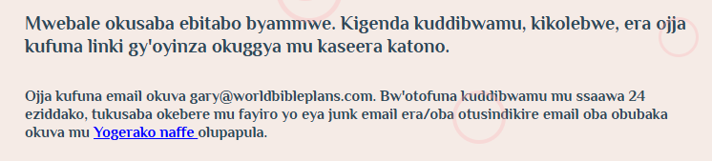
Omuko gw'Okuweereza Obuwanguzi
Kikulu nnyo okwongera gary@worldbibleplans.com ku lukalala lw’abaweereza bo abataliiko bulabe
  Bwe kitaba ekyo, attachment yo oba link yo eyinza okuggwa mu folda ya junk oba spam
Obudde bw’okukyusa okusaba tebuwera ssaawa 24 okuggyako nga waliwo embeera ezikendeeza
  Bw’oba ​​tofuna email okuva ku gary@worldbibleplans.com mu ssaawa 24, kebera mu folda yo eya junk oba spam.
    Bw’oba ​​n’okutuusa kati tonnafuna email okuva gye tuli, tuweereze akawandiiko okuva ku mukutu gwaffe ogwa Contact Us

