Slide 1
worldbibleplans.com
Step by Step Instructions

Slide 2
As a Christian, have you ever read through the entire Bible?
Why Not?
No
Do you think it’s important as a Christian to read the entire Bible
No
Yes
Was it Beneficial to your life?
Yes
Did you use a reading plan?
Yes
No
Yes
No
It’s too boring?
What’s stopping you from reading the entire Bible?
It’s too daunting? It’s a large difficult book to read?
Why Not? Would a simple reading plan have helped add benefit?
Did the reading plan make the task more manageable?
Would a custom crafted reading plan have made the task more manageable?
No
Yes
It takes too much time?
Plans including scriptures are too expensive?
Yes
Yes
Yes
Yes
No
Yes
WBP provides FREE plans with multiple themes such as Chronological, M’Cheyne, etc. to add some variety
WBP has FREE Bible reading plans that support any time commitment from 5 minutes to 60 minutes per day or any number of days per week.
WBP provides FREE plans in easy to read translations. Even the biggest tasks become doable when broken down into small, easy to manage steps.
At WBP, we believe reading the Bible adds tremendous benefit to all our lives.
What plan did you use? WBP has a huge variety to choose from.
Try a FREE plan at WBP
If you have tried and failed to read the Bible, visit us at https://worldbibleplans.com and craft a FREE custom Bible reading plan. Select from a variety of languages, translations, time commitments, themes, and ebook formats. It’s this simple. Craft a plan, WBP creates it, and in less than 1 day you get a link to download your custom FREE crafted Bible Reading Plan with or without scriptures. Did we mention everything is FREE!

Slide 3
Welcome to World Bible Plans
Simple to follow step by step instructions to craft your custom Bible Reading Plan in slide format.

Slide 4
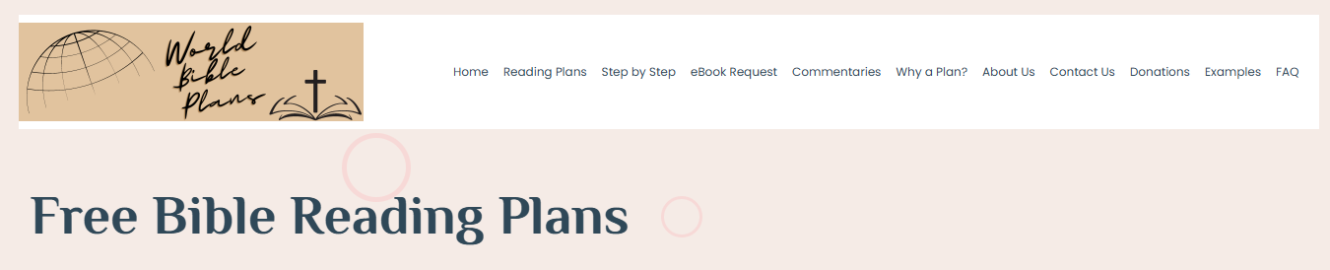
Navigate to the “eBook Request” page

Slide 5
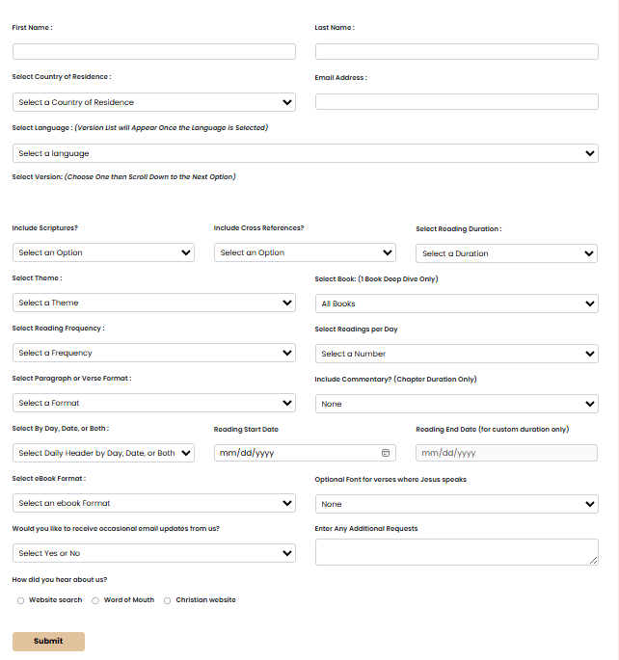
This is the Request Form – We will break it down in the following slides

Slide 6
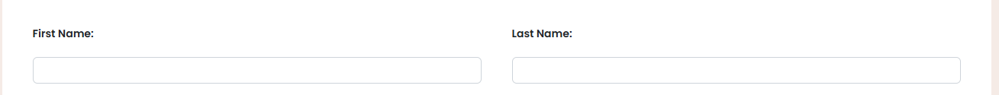
Tell us who you are

Slide 7
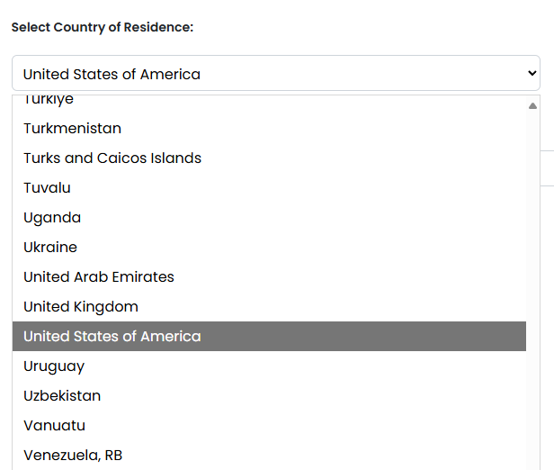
Select your Country of Residence from the drop down list
Click on the drop down to see the country of residence list
  Scroll to your country of residence choice or
  Start typing to more quickly get to your country of residence choice
  Click on your country of residence choice
    “United States of America” in this example

Slide 8
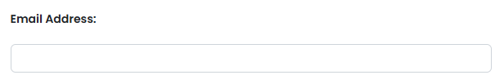
Enter your Email Address
We need your email address to send you a link to download your custom crafted Bible reading plan. Unless you ask us not to when you submit your request, WBP will send occasional emails with updates, new translations, and new plans
We will never share your email address with anyone for any reason

Slide 9
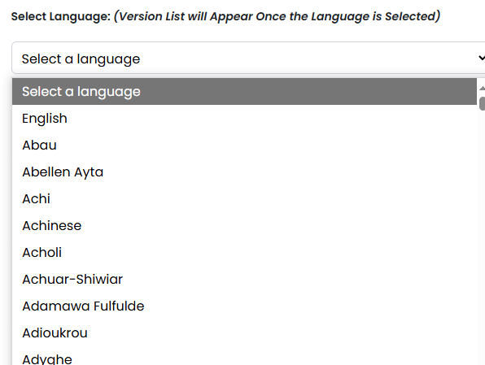
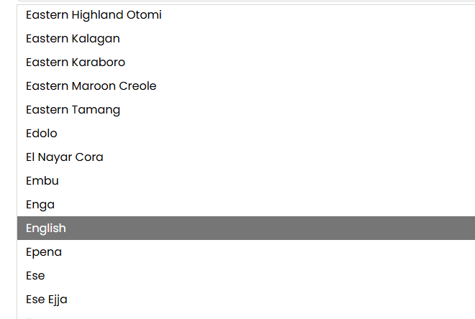
Select Your Language
Click on the drop down to see the language list
  Scroll to your language choice or
  Start typing to more quickly get to your language choice
  Click on your language choice
    “English” in this example

Slide 10
The version list associated with your language choice will auto populate
The version list is alphabetical. The description of the specific translation will tell you if the translation is:
  Complete Bible without Apocrypha – 66 Books (The Old and New Testaments)
  Complete Bible with ? Apocryphal Books (The Old and New Testaments with some Apocryphal Books. The “?” represents the number of books.
  New Testament Only – The 27 books of the New Testament
  New Testament with Other Books - The 27 books of the New Testament plus some number of Old Testament Books
  Old Testament Only – The 39 books of the Old Testament
  Missing “?” Book(s) – Some translations are missing books. The “?” represents the number of books missing
  “?” Books – Some translation have a limited number of books. The “?” represents the number of books in the translation

Slide 11
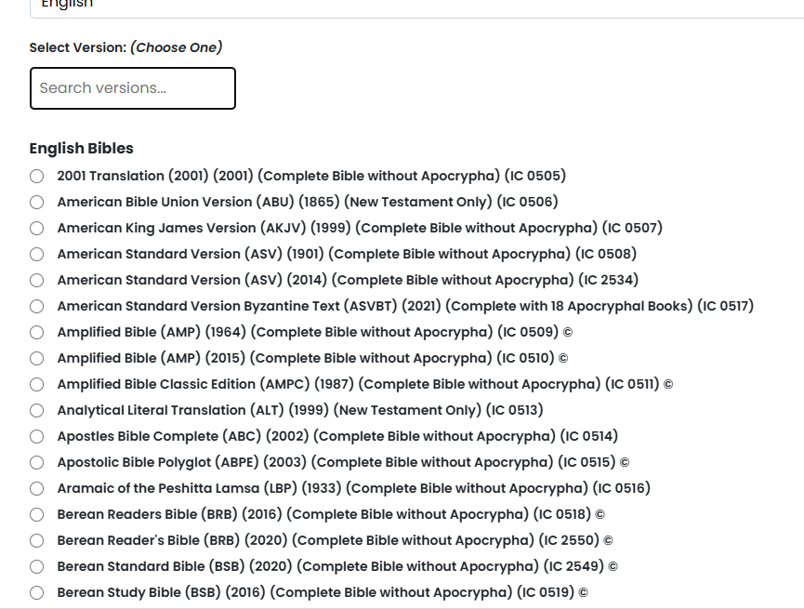
This is a modified example of what you might see
Search within the List
The (IC xxxx) is an internal code we use in processing your request

Slide 12

Copyrighted Versions
Some fields on the form will be locked if you choose a copyrighted Bible version. By law, we can only provide a guide for copyrighted versions. You will see the copyright symbol "©" at the end of the version description.
By law, we are not permitted to provide the scriptural text for Bible versions under a current copyright. Any version that is under a current copyright will have the symbol “©” at the end. For these versions, we can only provide a guide.
If you choose a version under copyright
  Include Scriptures will default to “No” and the field will be locked
  Select Format will be locked
  Select eBook Format will default to “PDF Chart” and the field will be locked
    Unless you also choose a commentary
  Red Letter Verses will be locked

Slide 13
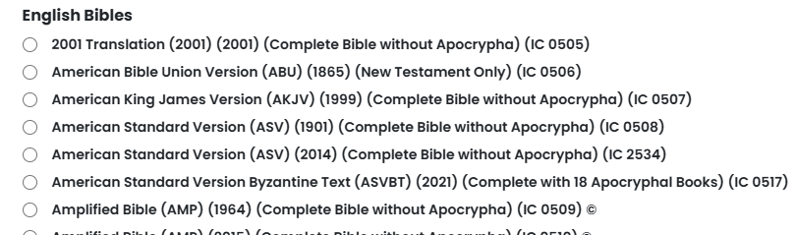
Click in the radial button at the beginning of your choice
In this example, I have chosen the “American King James Version (AKJV) (1999) (Complete Bible) (IC 0507)
  Note: You can only make one choice per request. If you want multiple versions, you must submit multiple requests

Slide 14
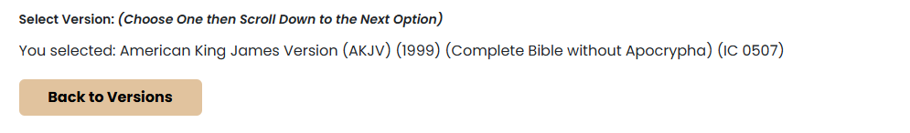
The dropdown list will close and the form will show the version you chose
You can change your selection by clicking on the “Back to Versions” button

Slide 15
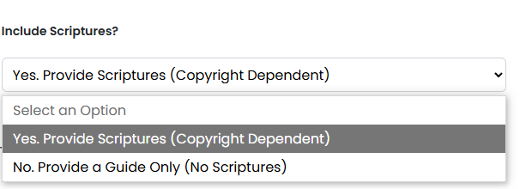
Click on the “Include scriptures” drop down
This option is to choose between
  Yes. Provide Scriptures – Include the scriptures in your reading plan (Copyright Dependent)
  No. Provide a Guide Only – Do not include the scriptures
    This option only includes the daily headings (available in pdf chart format)
    This option is for those who wish to use their own hard copy Bible or for Bible versions under a current copyright

Slide 16
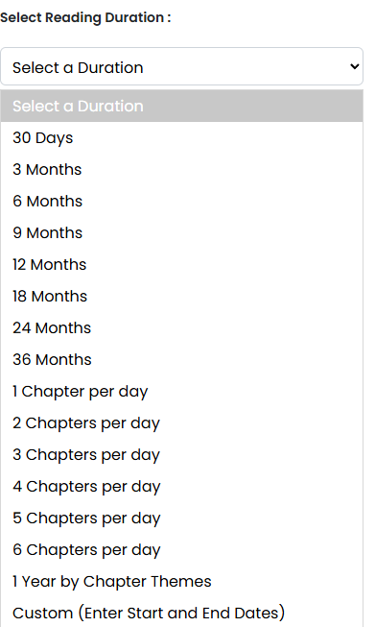
Select the “Reading Duration” drop down and click on your selection
Choose 1 Year by Chapter Themes for Old/New and New/Old by Chapter Themes
Choose Custom if you want to set the start and finish date further down the form
Choose from as little as 30 days or as long as 3 years.
Or Choose from 1-6 chapters per day
  1-6 Chapter durations are only available for “linear” themes (1 Book Deep Dive, Straight (Genesis to Revelation), Old Testament Only, New Testament Only, Psalms & Proverbs, Apostles & Paul, Old Testament Major and Minor Prophets, and Torah)
  The duration for chapters is dependent on the translation you choose
  Commentaries are only available with chapter durations (including 1 Year by Chapter)
Or create a custom duration by entering the start and finish dates below

Slide 17
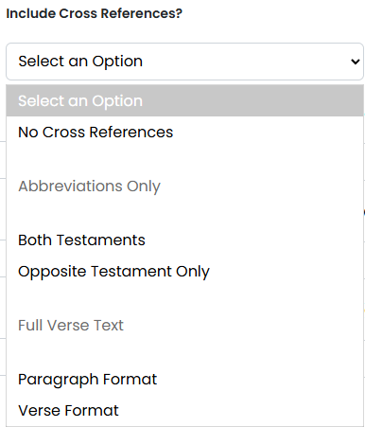
Optionally select the “Include Cross References?” drop-down and select
Choose between abbreviations and scriptural cross references
  For full verse text, WBP offers New Testament references for Old Testament verses and vice versa.
  For abbreviations, WBP offers all cross-references or New Testament references for Old Testament verses and vice versa.
Cross references are not available for copyrighted versions.
Your plan must include scriptures.
Only works with the verse format.
Google AI - A bible cross-reference is a note that directs a reader to another verse or passage in the Bible with a related theme, word, or idea, helping to connect different parts of scripture and enhance understanding. These references link related concepts, prophecies, and events, allowing one passage to shed light on another.

Slide 18


Include Cross Reference?” Examples
Example 1 – All Abbreviations. In this example, there are Old Testament and New Testament references
Example 2 – Abbreviation for opposite Testament only. In this example, there are only Old Testament references

Slide 19


Include Cross Reference?” Examples
Example 3 – Full verse cross references. In this example, there are only Old Testament references in paragraph format
Example 4 – Full verse cross references. In this example, there are only Old Testament references in verse format

Slide 20
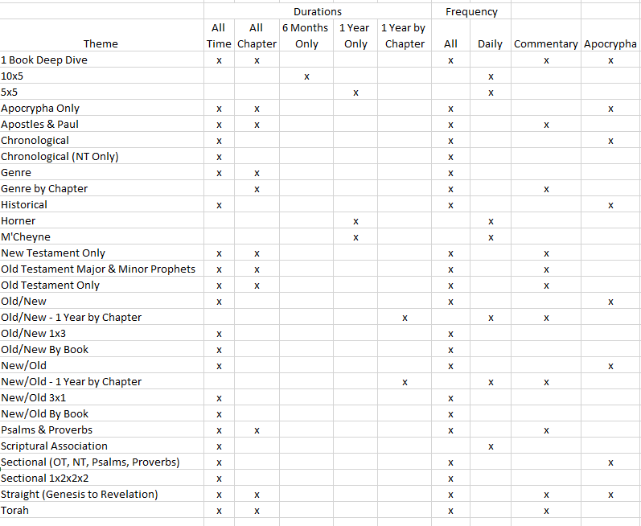
There are compatibility issues with some themes, durations, and frequencies. Use this matrix as a guide
Certain themes have specific restrictions
  For example, the 10x5 theme must have a 1-year duration and a daily frequency

Slide 21
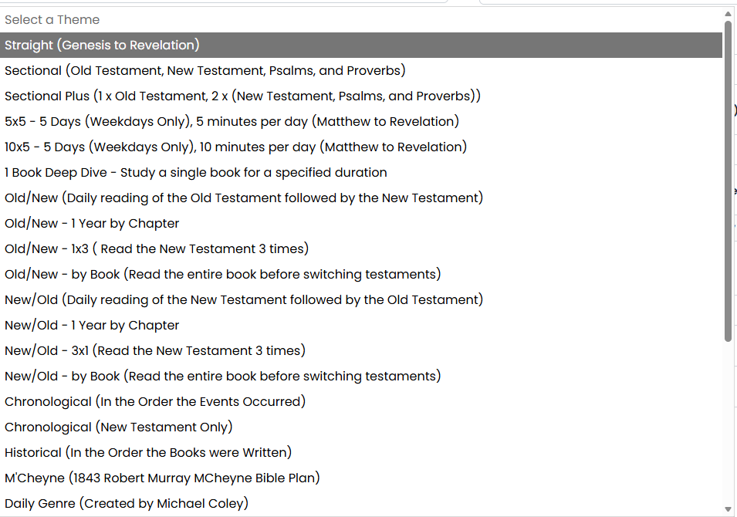
Click on the “Select Theme” dropdown and make your selection
If you chose a time duration (3 month, 3 year, etc.), all themes are available
Choose from 29 different themes (partial list in screen print)

Slide 22
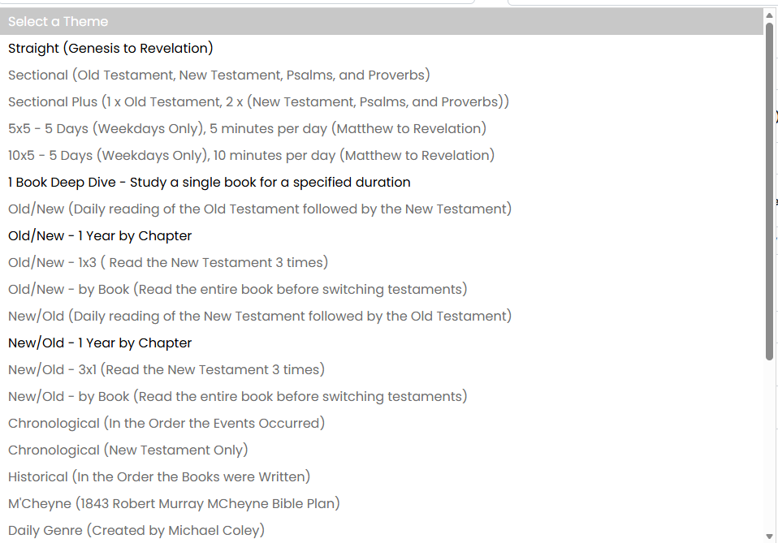
If you chose a “Chapter” duration (including the 1 Year by Chapter), the grayed out themes are unavailable
Choose from 11 different themes (Screen Print Incomplete)

Slide 23
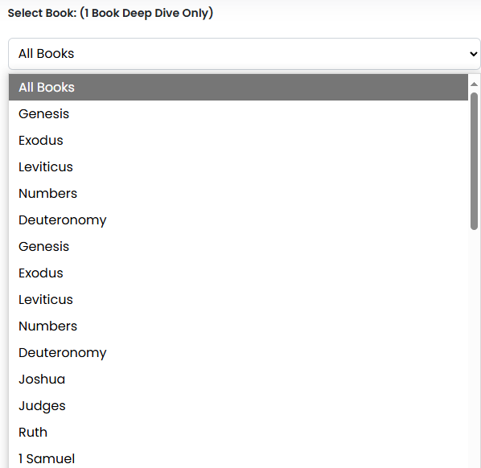
If you chose the “1 Book Deep Dive” theme, select a book. Otherwise, this option will be locked
Only one book can be chosen
Available books are dependent on your version
  For example, if you choose a version that is the New Testament Only, you can’t choose “Genesis”

Slide 24
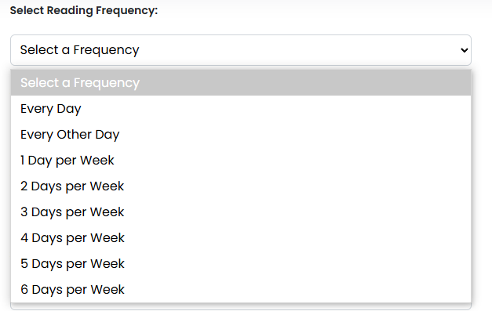
Click on the “Select Reading Frequency” dropdown and make your selection
Choose from:
  Every Day
  Every Other Day
  1-6 Days per Week

Slide 25
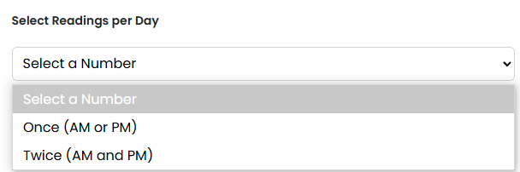
Click on the “Select Readings per Day” dropdown and make your selection
Choose from:
  Once per Day (a.m. or p.m.)
  Twice per Day (a.m. and p.m.)

Slide 26
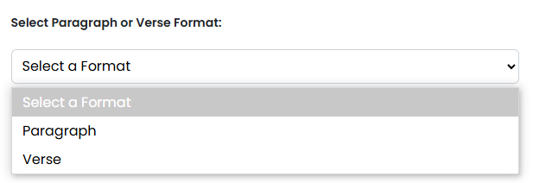


Click on the “Select Paragraph or Verse Format” dropdown and make your selection
Paragraph Example
Verse Example

Slide 27

Click on “Include Commentary?” Select a chapter by chapter commentary included with your plan.
Select from 155 commentaries in 15 languages
  This is optional. If you don’t wish a commentary, leave as “None”
Chapter by chapter commentaries are only available using the "chapter" durations and with the following themes: 1 Book Deep Dive, Straight (Genesis to Revelation), Old Testament Only, New Testament Only, Psalms & Proverbs, Apostles & Paul, Old Testament Major and Minor Prophets, and Torah. They are currently available in English, Spanish, French, Italian, Portuguese, Russian, and more.

Slide 28

Click on the “Select By Day, Date, or Both:” dropdown and make your selection
By Day – Example – Day 1, Day 2, etc.
By Date – Example – January 1, January 2, etc
By Day and Date – The header will show both with the Day first
By Date and Day - The header will show both with the Date first

Slide 29
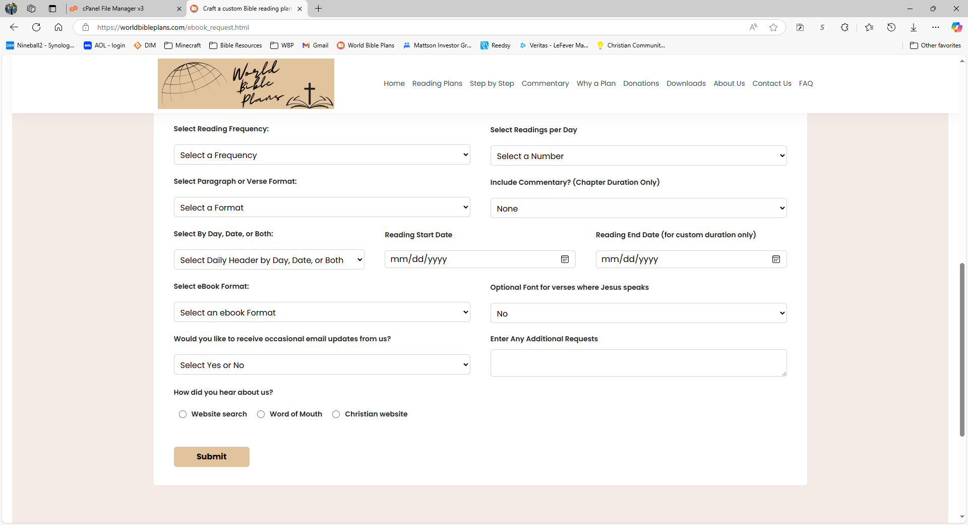


Click on the calendar to choose a reading start date. If you chose “Custom Duration,” choose a reading end date
Skip this step if you chose to read “By Day” in the previous step
Only enter a value if you chose “Custom Duration.”

Slide 30
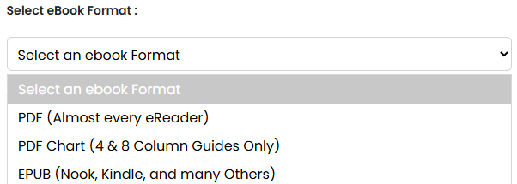
Click on the “Select eBook Format” dropdown and make your selection
Your choice is dependent on whatever eReader you wish to use.
  PDF – A universal format used by web browsers and other e-Readers
  PDF Chart – Both 4 & 8 column - This is reserved specifically for the guide selection
  EPUB – This selection is used in the Barnes and Noble Nook App and most other e-readers apps
You can only choose one of these. If you wish to have your reading plan in another format, you can make another request or let us know in the “Enter Any Additional Requests Here” text box and we will try to accommodate.
For PC use, we recommend the EPUB format, which is supported by the free Ice Cream Reader available at Free EPUB Reader for Windows - Icecream Apps.

Slide 31
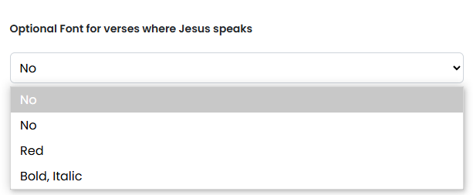
Click on the “Optional Font for verses where Jesus speaks” dropdown and make your selection
The entire verse, where Jesus speaks, can optionally be in a red or bold, italic font.
  Select “No” to use the default font
This option only applies if you “Include Scriptures”

Slide 32
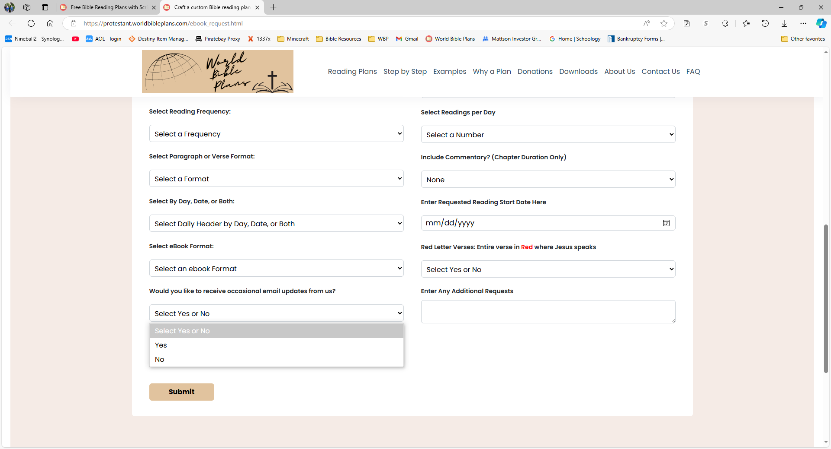
Optional: Select “No” if you wish to not receive emails from WBP

Slide 33
Optional: Enter any additional requests here
You can make any additional request in the free form text box.
For example, you may want your reading plan in multiple formats or a different format other than what is listed. We will accommodate any request if we can.
You may want to mix and match. Select the Old Testament from one version and the New Testament from another for example.
  This can be done via the additional request or send us a note from our Contact Us page
  This type of request will take a bit longer to process on our end

Slide 34
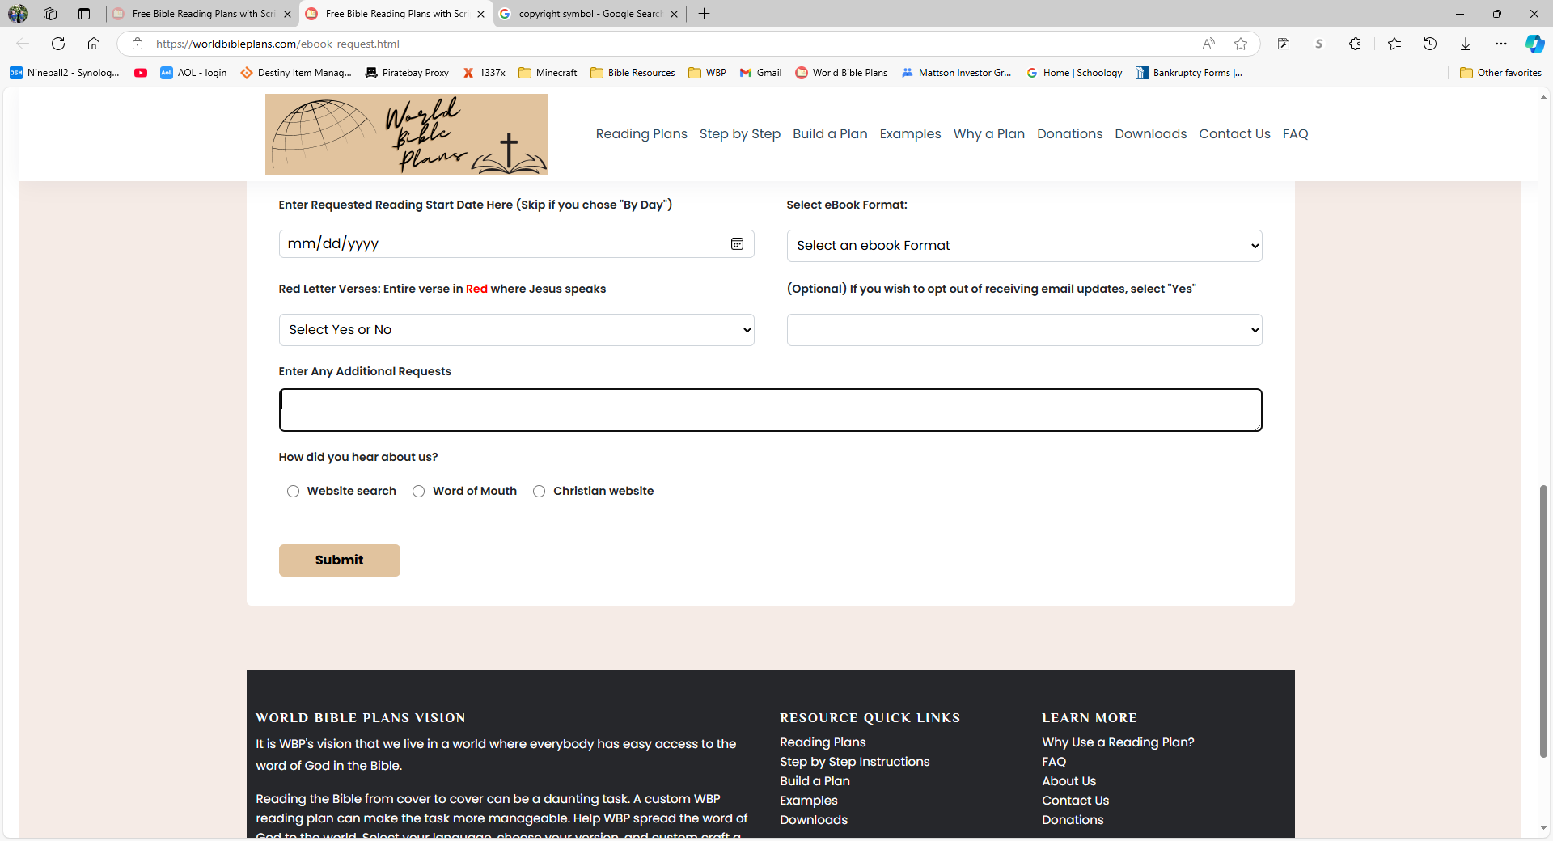
Please let us know how you heard about us
This information will help us reach as many people as possible

Slide 35
Finally, click submit
Once you submit your request, WBP will receive and process your request, and email a download link to your WBP reading plan on our Google Drive
  If the file is small enough, we will email it to you. If not, we will post it and provide a link.
  Please allow for up to 24 hours to receive your download link. We are a very small operation. Rarely, processing may take more than 24 hours.

